Slide 1

PatraVision
AI POWERED VISION FOR PLANT HEALTH
-Vishal L Shettigar

Slide 2

About the Domain
My project "PatraVision – AI-Powered Vision for Plant Health" falls under both Artificial Intelligence and Image Processing
PrimaryDomain:
Supporting Domain:
Artificial Intelligence (AI)
Image Processing
Because I’m using machine learning (deep learning, like CNNs) to classify plant diseases based on image data. The system learns from a dataset and makes predictions — that's AI.
Because I’m working with image data — converting, resizing, and pre-processing leaf images — before passing them into the AI model. Tasks like converting BGR to RGB, normalization, etc., fall under Image Processing.

Slide 3

Why "PatraVision"?
About the title:
"Patra" – A Sanskrit word meaning "Leaf," representing the focus on plant leaves for disease detection.
"Vision" – An English word symbolizing AI-powered clarity, analysis, and the ability to detect hidden plant diseases.
Subtitle: "AI-Powered Vision for Plant Health"
This subtitle highlights how the system:
✅ Uses Artificial Intelligence to analyze plant health effectively.
✅ Employs Computer Vision to detect diseases in leaves with precision.
✅ Enables real-time monitoring, ensuring early detection and prevention of diseases.
Objective:
Plant diseases pose a major threat to global agriculture and food security. Traditional methods of detecting these diseases rely heavily on human expertise, which can be time-consuming, inconsistent, and often unavailable in rural or remote areas. With advancements in artificial intelligence and image processing, it's now possible to automate the identification of plant diseases using leaf images.

Slide 4

About the project
My project utilizes AI-driven image processing to detect plant diseases with high accuracy.
📊 Dataset:
- 🌿 Training Set:70,295 images
- 🌾 Validation Set: 17,572 images
- 🌱 Test Set: 33 images
Technology Stack:
Deep Learning
Convolutional Neural Networks (CNNs)
AI-based image analysis
🏆 Impact:
Supports precision agriculture
Helping farmers make Data-driven decisions for improved crop health.

Slide 5
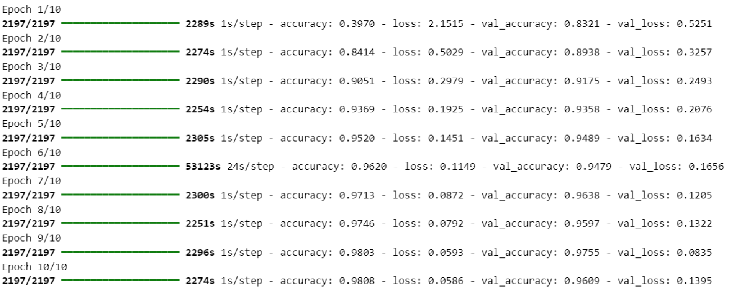
Accuracy and Loss
Validation Accuracy: 0.9609 (or 96.09%)
This means your model is able to correctly predict plant diseases in 96 out of 100 cases on the unseen (validation) dataset.
Summary of Accuracy:
Training Accuracy (Final Epoch): 98.08%
Validation Accuracy (Final Epoch): 96.09%
Summary of Loss:
Training Loss(Final Epoch):5.86%
Validation Loss(Final Epoch): 13.95%
This high accuracy indicates that your model is well-trained and performs effectively on new data, making it a strong candidate for real-world use.This combination of high accuracy and low loss confirms that the model is both accurate and consistent, without signs of significant overfitting.

Slide 6

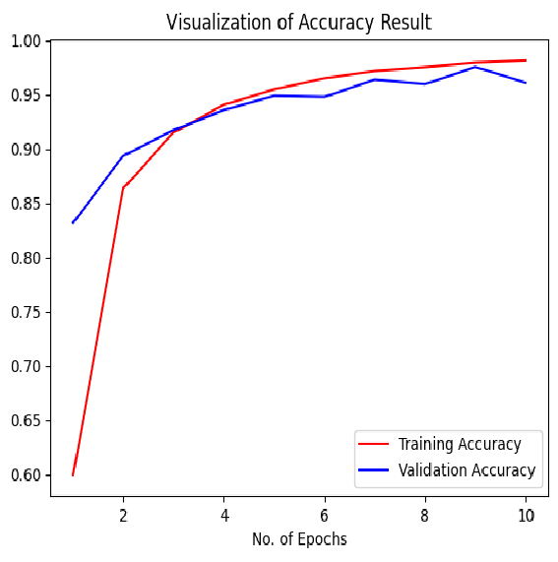
Visualization of Accuracy
Result

Slide 7
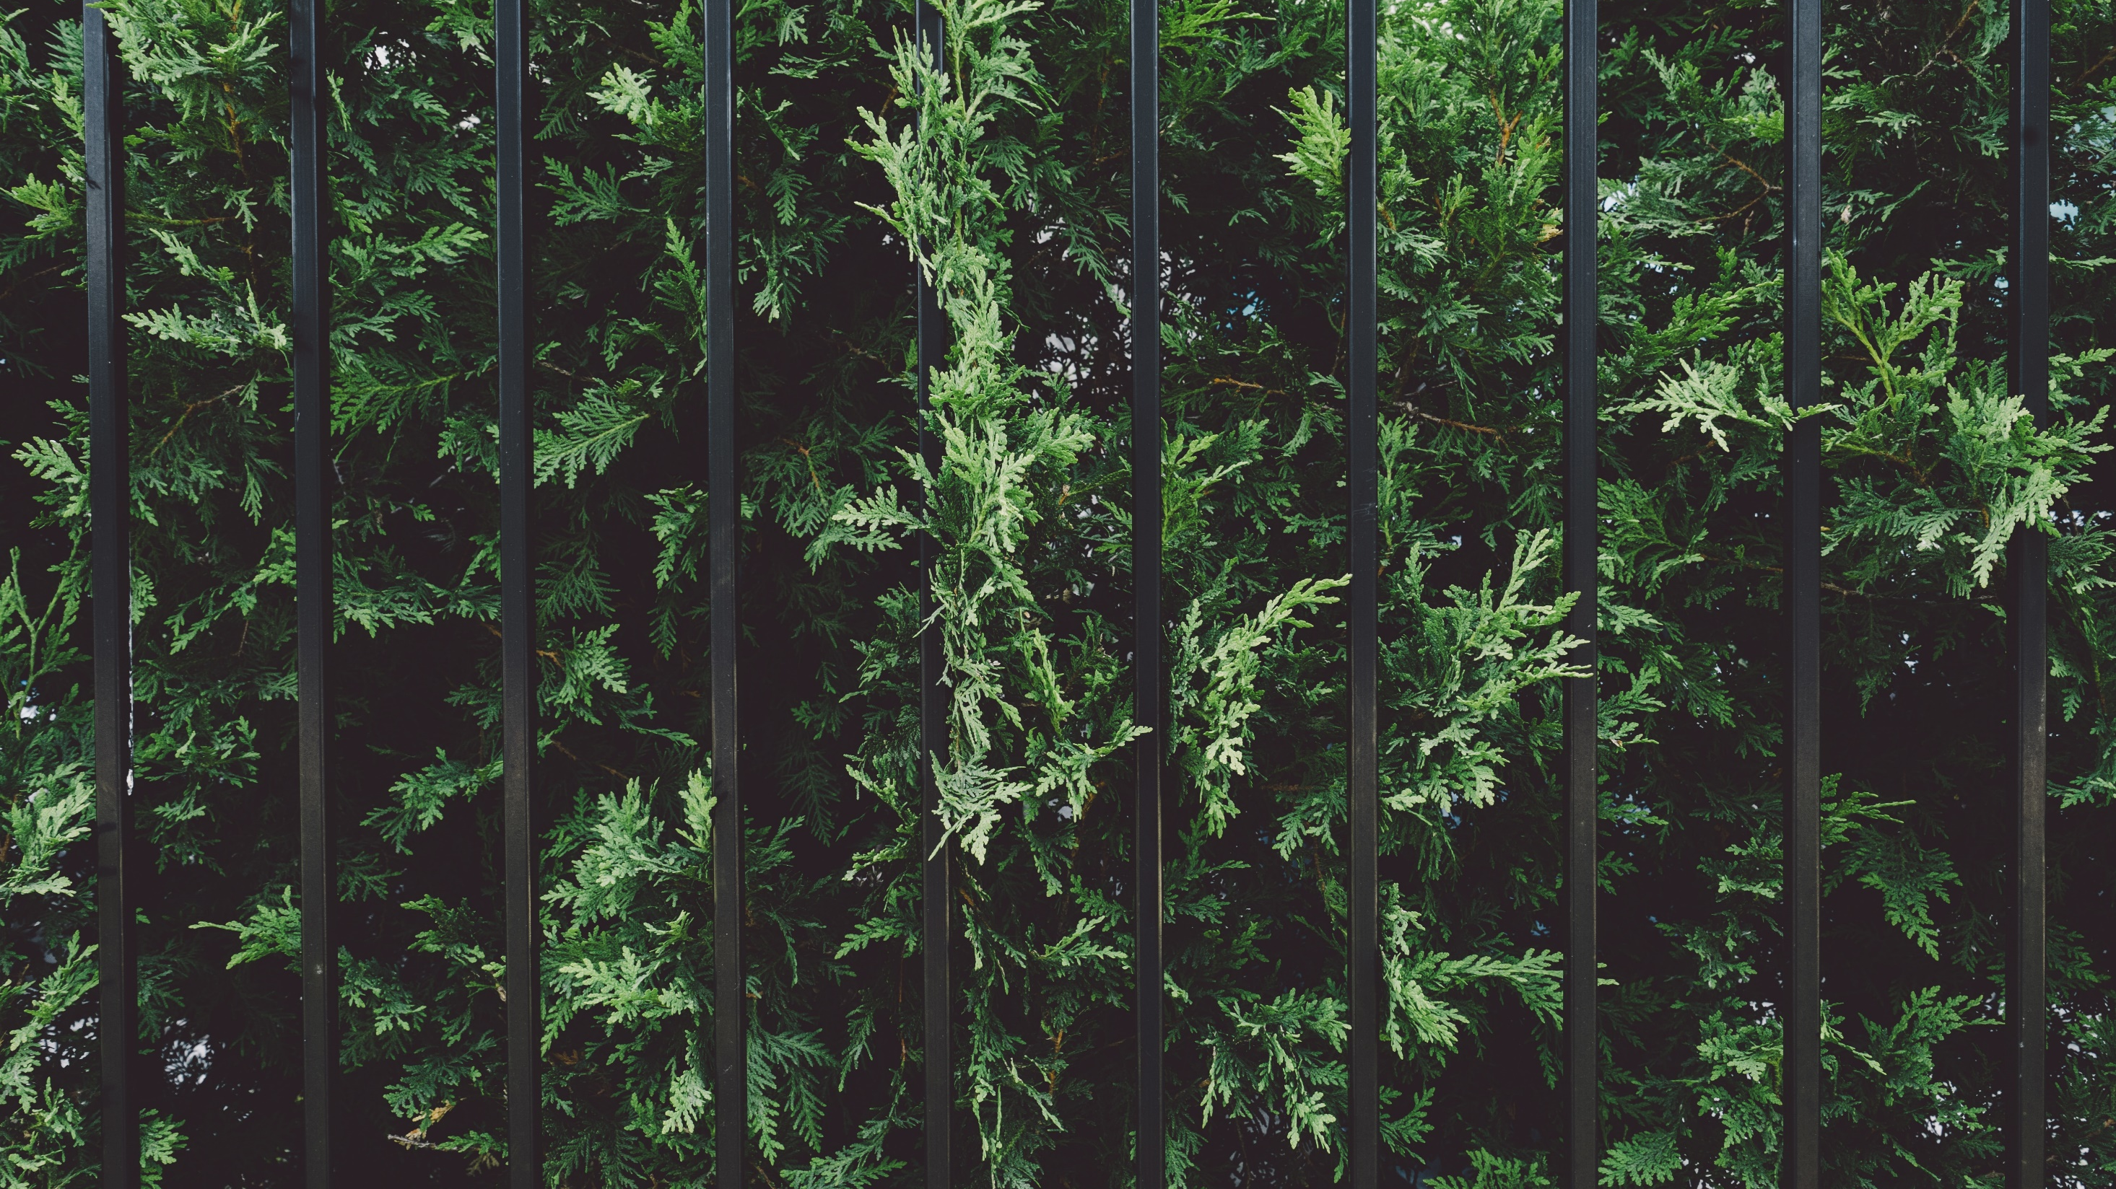
Thanks
All About Plants
Healthy Plants, Healthy Future!

